Slide 1

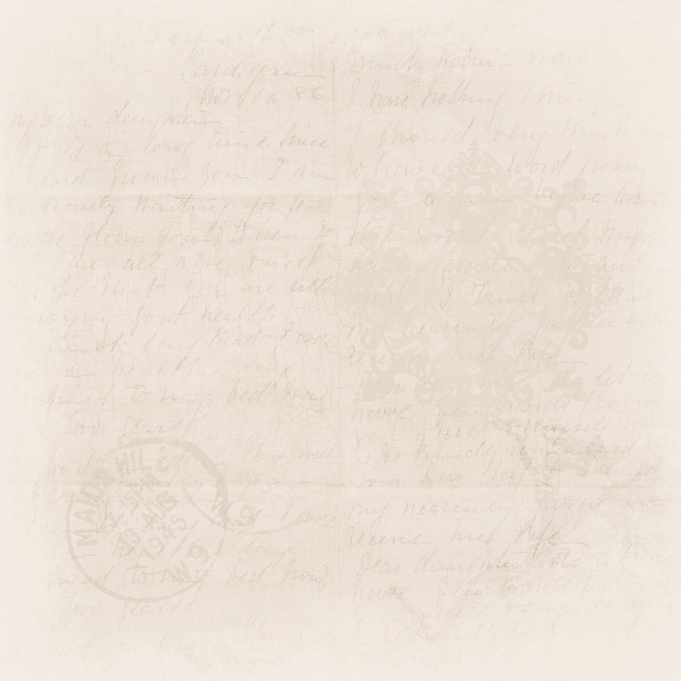



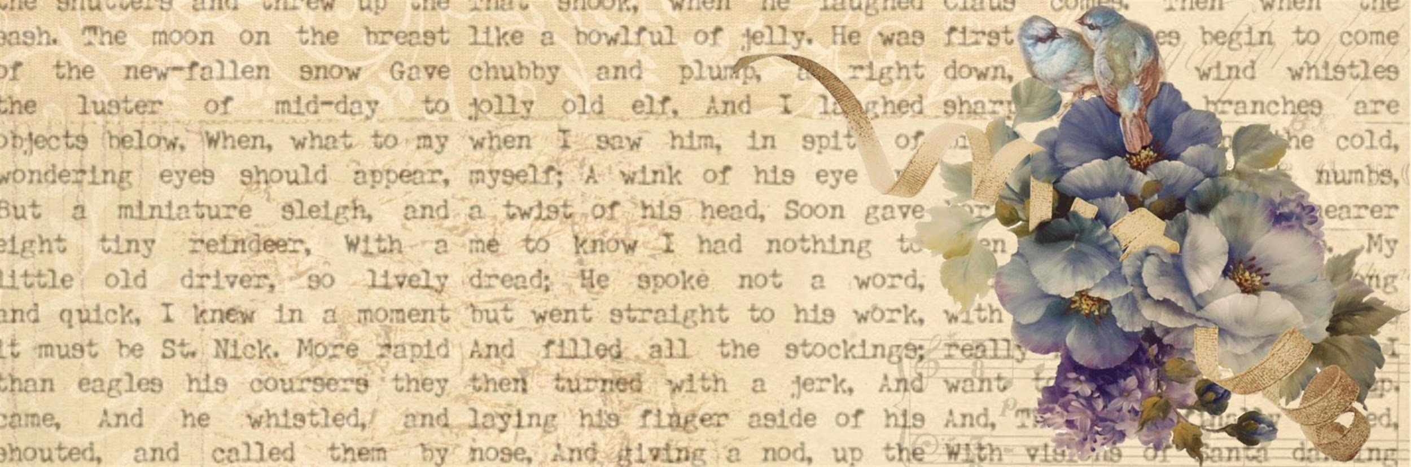
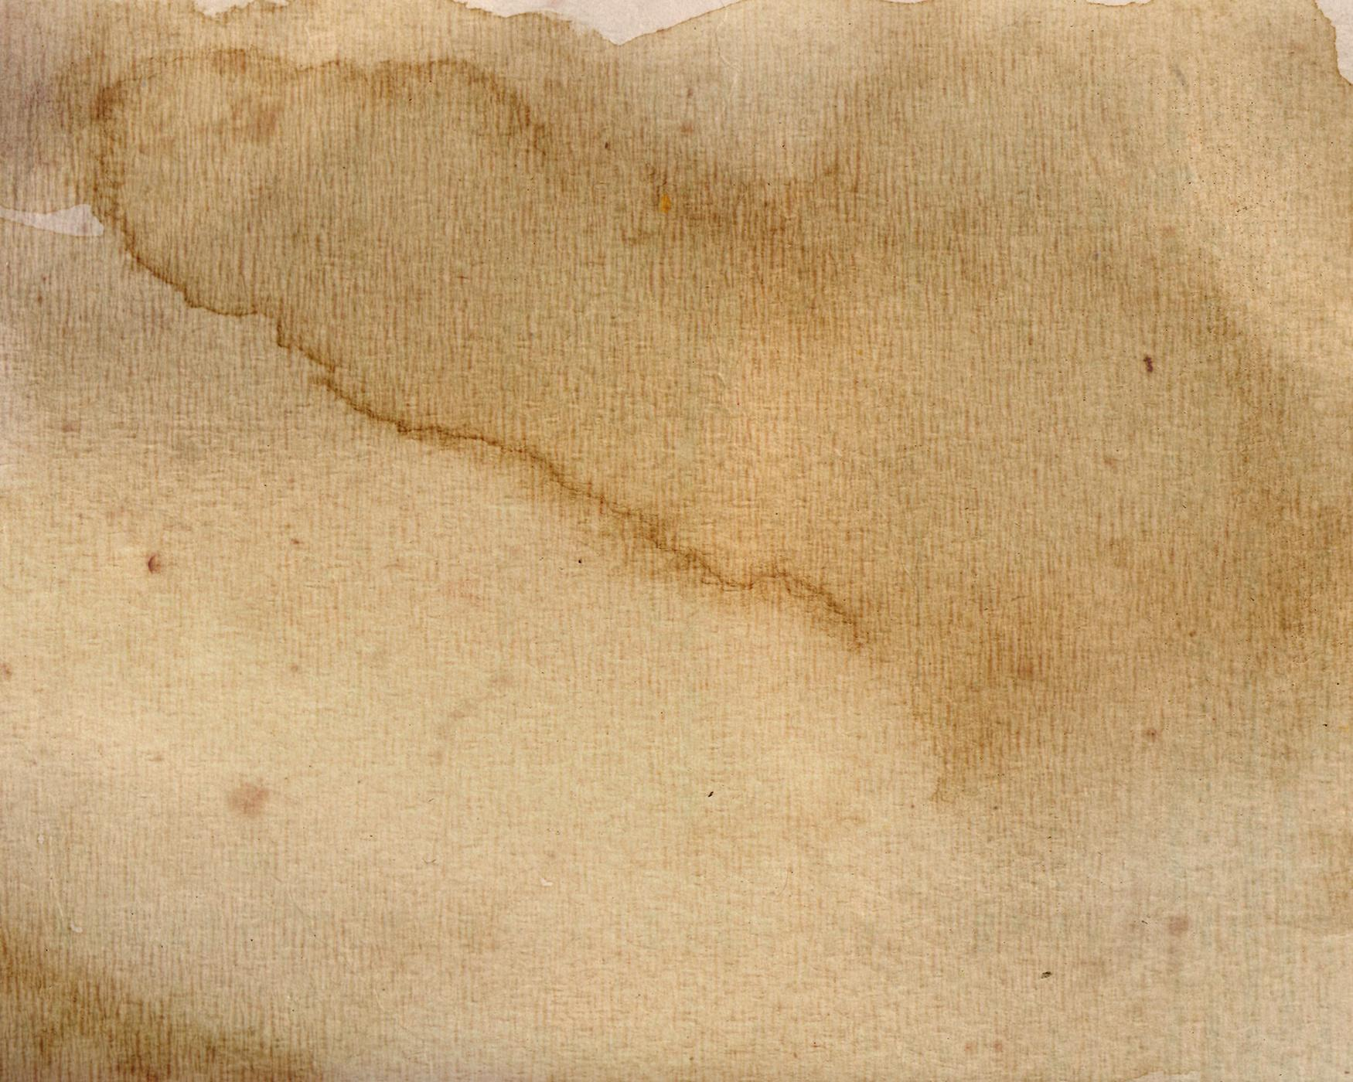
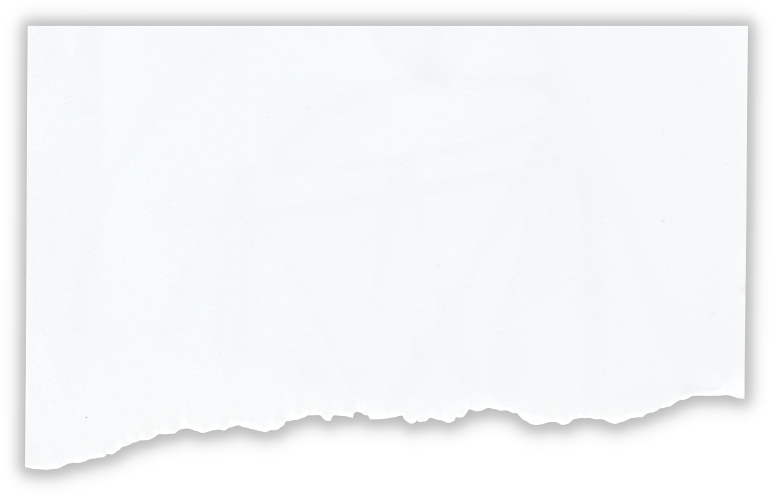
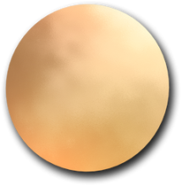

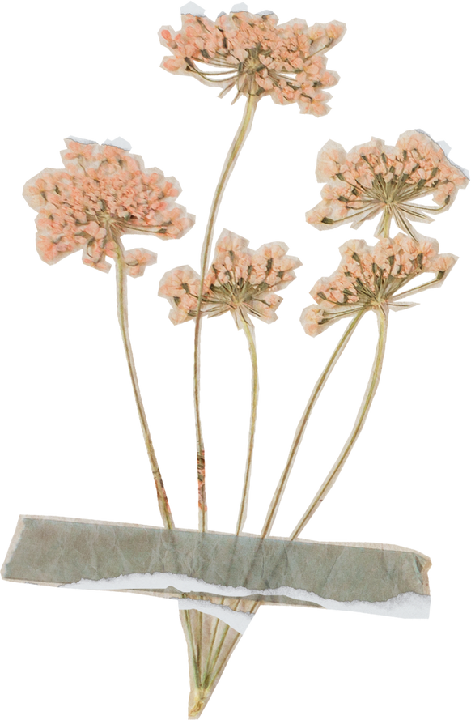
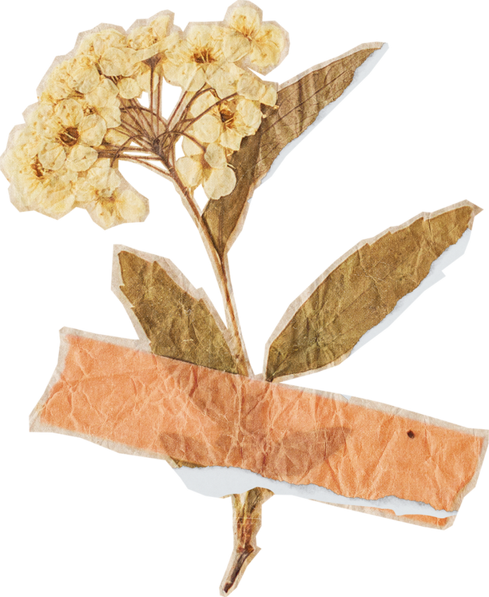
Vocabulary

Slide 2
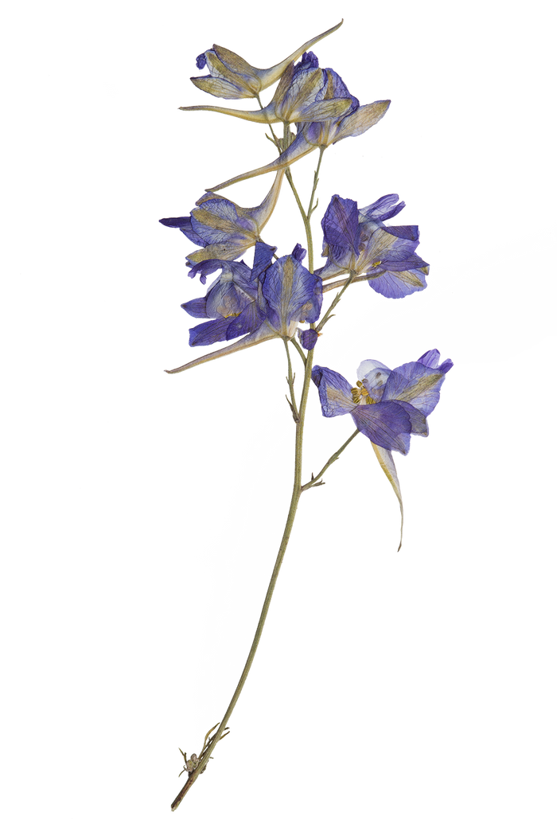
Vocabulary
It refers to the words needed
for communicating effectively.
Receptive vocabulary
Expressive vocabulary

Slide 3
Why do we need vocabulary?
To communicate and express
To read comprehension
To align thinking vocabulary with
linguistic vocabulary
To convey anything
To form a basis for judgment

Slide 4
Prefix?
Suffix?

Slide 5
Prefix
A prefix is a group of letters added to the beginning of a word to change its meaning.
For instance: "unhappy"
Un+ happy
"un-" is the prefix that means "not," altering the meaning of "happy."

Slide 6
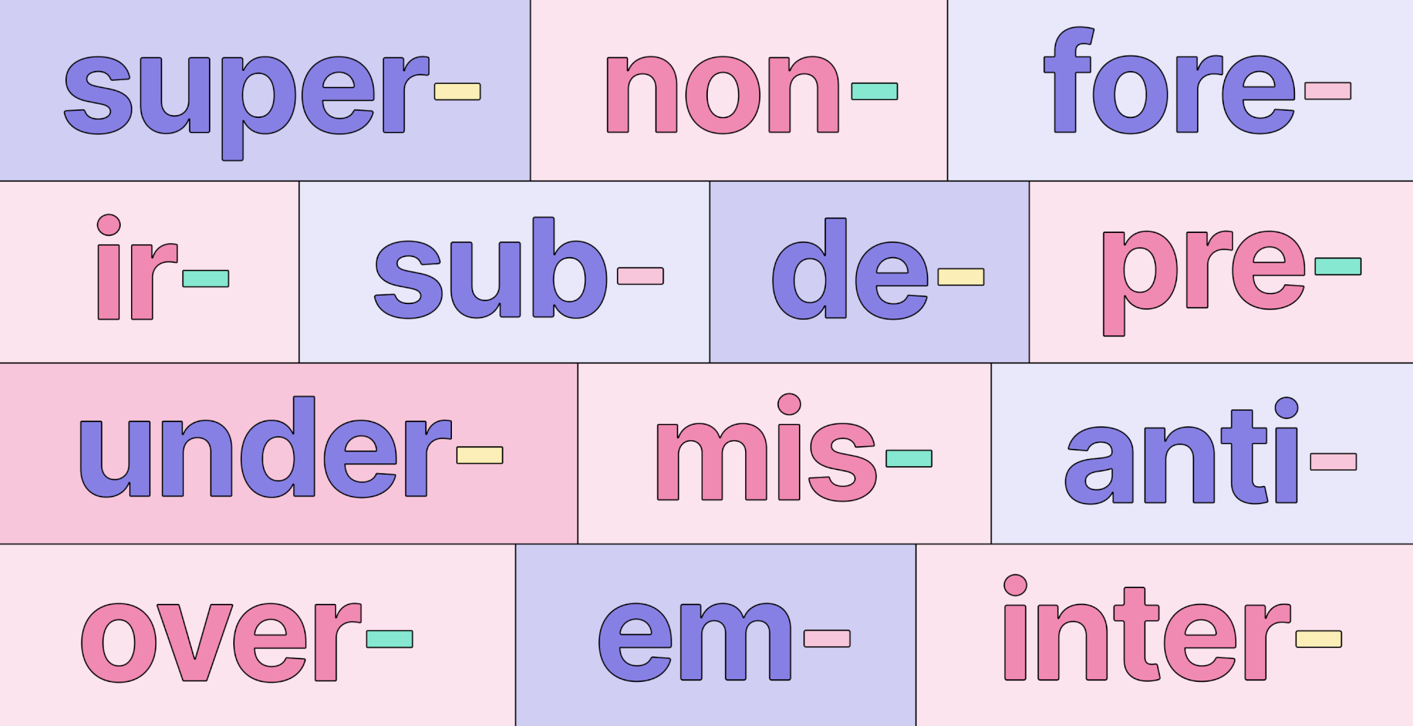
Prefixes

Slide 7
More Examples can be...
Semicircle
Neoclassical
Misunderstanding
Midwinter
Omnivore

Slide 8
Which of these words does not have a prefix?
a. Redo
b. Homework
c. International
d. Antidote

Slide 9
Which of these words does not have a prefix?
a. Redo
b. Homework
c. International
d. Antidote

Slide 10
Choose the correct Prefix to make an opposite of the word:
Do
1. To
2. Mis
3. Un
4. In

Slide 11
Choose the correct Prefix to make an opposite of the word:
Do
1. To
2. Mis
3. Un
4. In

Slide 12
What does the prefix "pre" in words like prepaid, pre-teen and prehistoric mean?
1. below
2. before
3. after
4. between

Slide 13
What does the prefix "pre" in words like prepaid, pre-teen and prehistoric mean?
1. below
2. before
3. after
4. between

Slide 14
Choose the correct prefix to make an opposite of the word:
Archy
2. Ab
3. Ad
4. A
5. An

Slide 15
Choose the correct prefix to make an opposite of the word:
1. Archy
2. Ab
3. Ad
4. A
5. An

Slide 16
Suffix
A suffix is a group of letters added to the end of a word to change its meaning or form.
For instance: Happiness (-ness): The state of being happy.

Slide 17
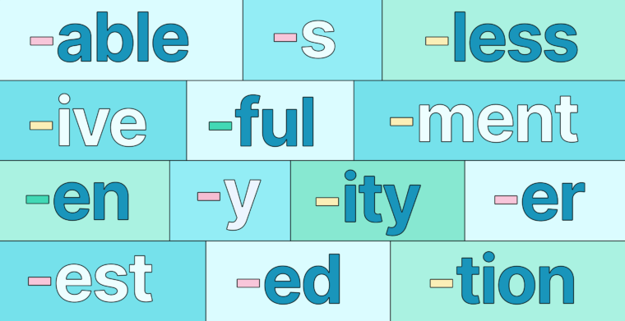
Suffixes

Slide 18
More Examples can be...
Washable
Creative
Employment
Careful
Fearless

Slide 19
Which of these words does not have a Suffix?
a. Development
b. Childish
c. Exposure
d. Toothpaste

Slide 20
Which of these words does not have a Suffix?
a. Development
b. Childish
c. Exposure
d. Toothpaste

Slide 21
Which suffix changes a verb into a noun?
A) -ly B) -able C) -tion D) -ful

Slide 22
Which suffix changes a verb into a noun?
A) -ly B) -able C) -tion D) -ful

Slide 23
Which suffix means "without"?
A) -ous B) -less C) -ment D) -able

Slide 24
Which suffix means "without"?
A) -ous B) -less C) -ment D) -able

Slide 25
or
Choose the correct suffix for the word: Moist
a. ................ify
b. ................ful
c. ................en
d. ................ed

Slide 26
or
Choose the correct suffix for the word: Moist
a. ................ify
b. ................ful
c. ................en
d. ................ed

Slide 27
or
Choose the correct suffix for the word: Smart
1. .........ness
2. ............ful
3. ........ment
4. ............ed

Slide 28
or
Choose the correct suffix for the word: Smart
1. .........ness
2. ............ful
3. ........ment
4. ............ed

Slide 29
or
Any query?

Slide 30
Thank
you

